Slide 1
In-Game UI

Slide 2
Tutorial UI

Slide 3
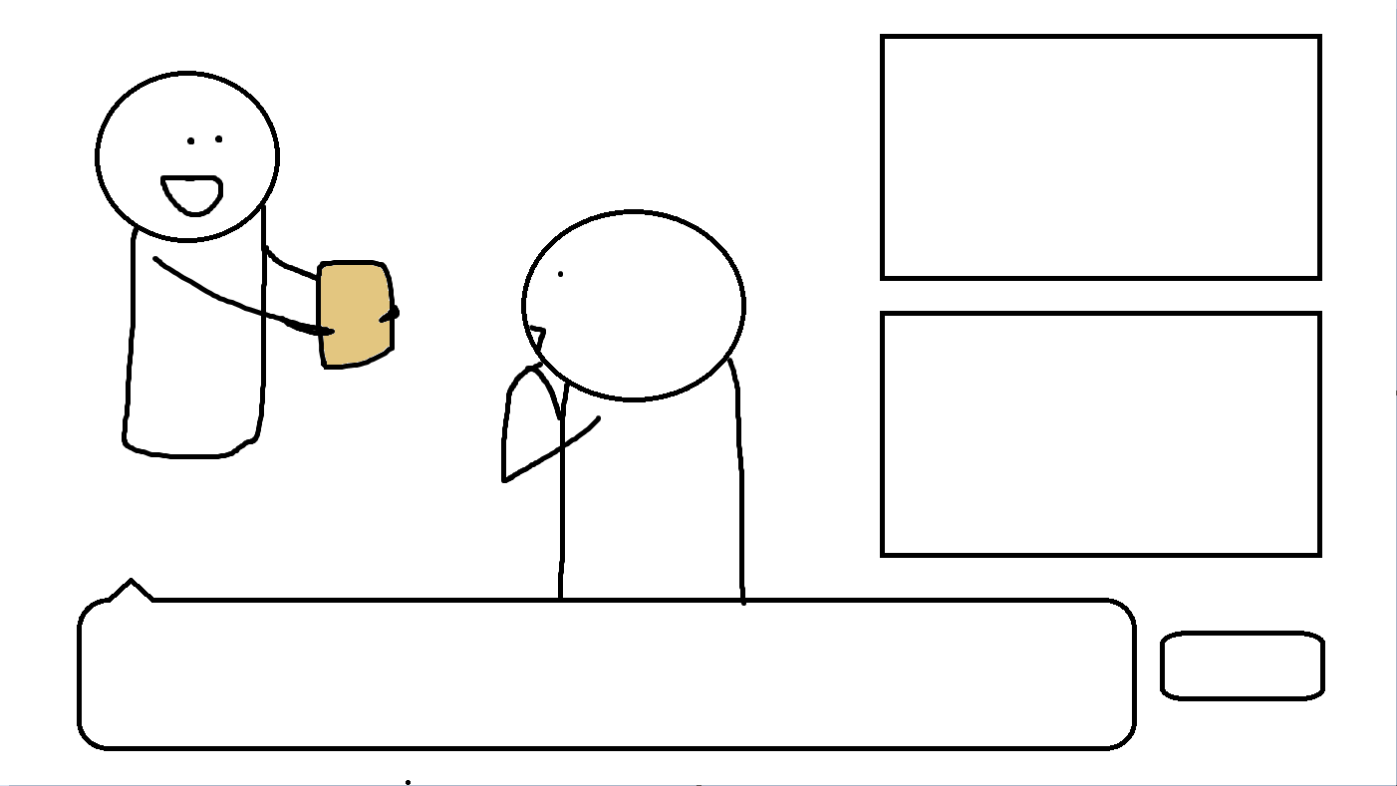
Dialogue UI
Click on either to move to selection screen
Choose Housings
Choose Grants
Click on dialogue box to move to next line
NPCs(Name):
Confirm only when grant and housing has been chosen
(From Dialogue)
Confirm

Slide 4
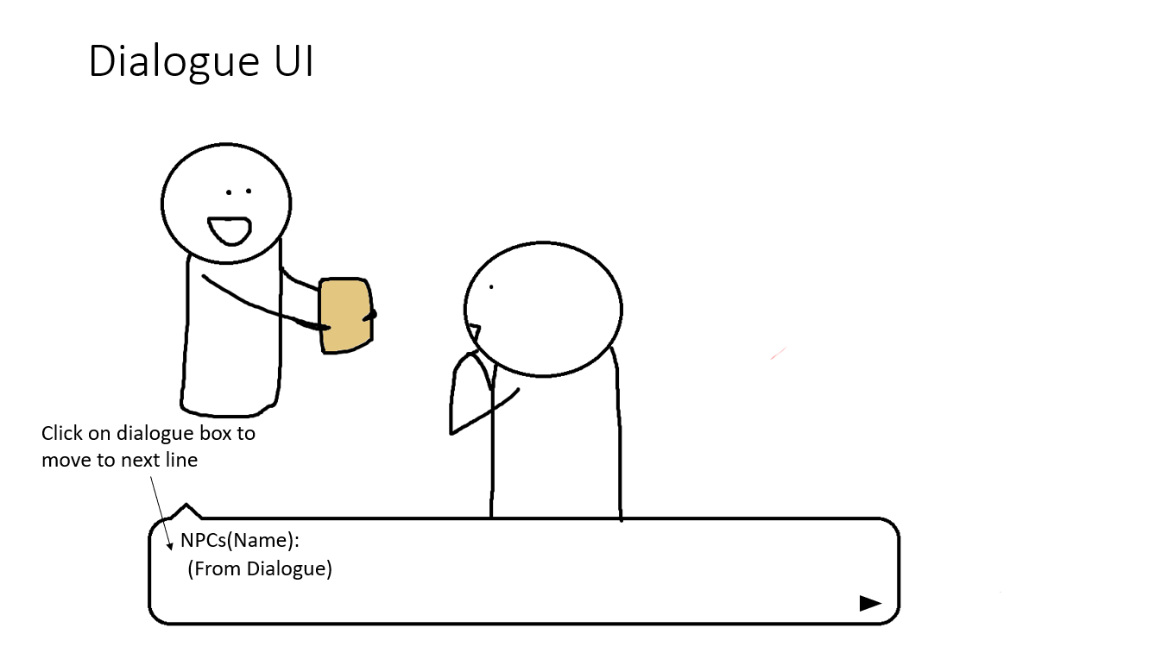

Choose Housings
Choose Grants
Confirm

Slide 5
Dialogue UI
Choose Housings
Choose Grants
Player can choose reply to NPCs
You:
Confirm
Option A
Option B

Slide 6
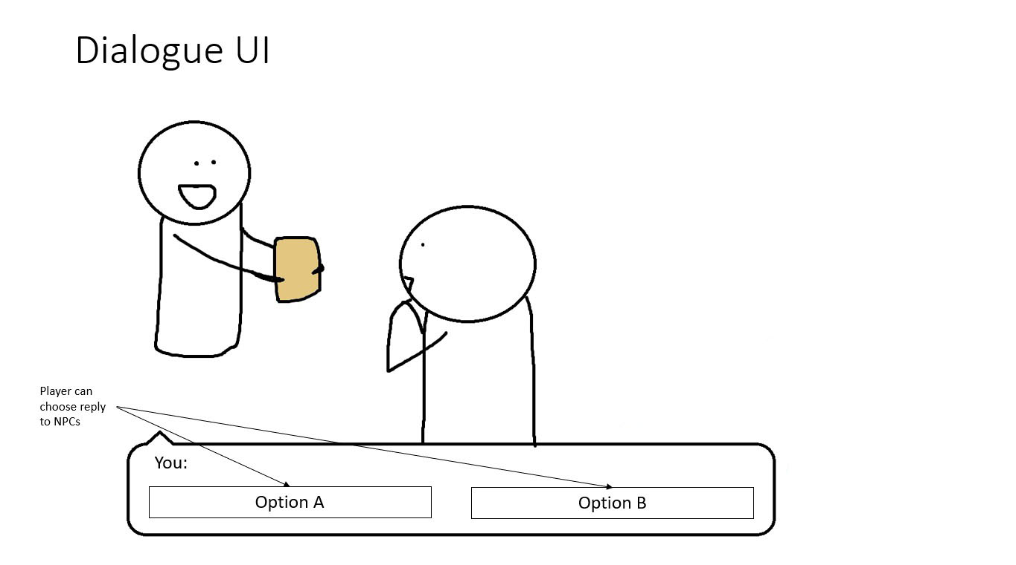
Choose Housings
Choose Grants
Confirm

Slide 7
Dialogue UI
When the player has confirmed their choice in specific scenes, it turns green when they come back here
Selected Housing Name
^title will change based on selection
Choose Grants
^same here
Player can choose to return to look at their choices before final confirmation
NPCs(Name):
(From Dialogue)
Confirm

Slide 8
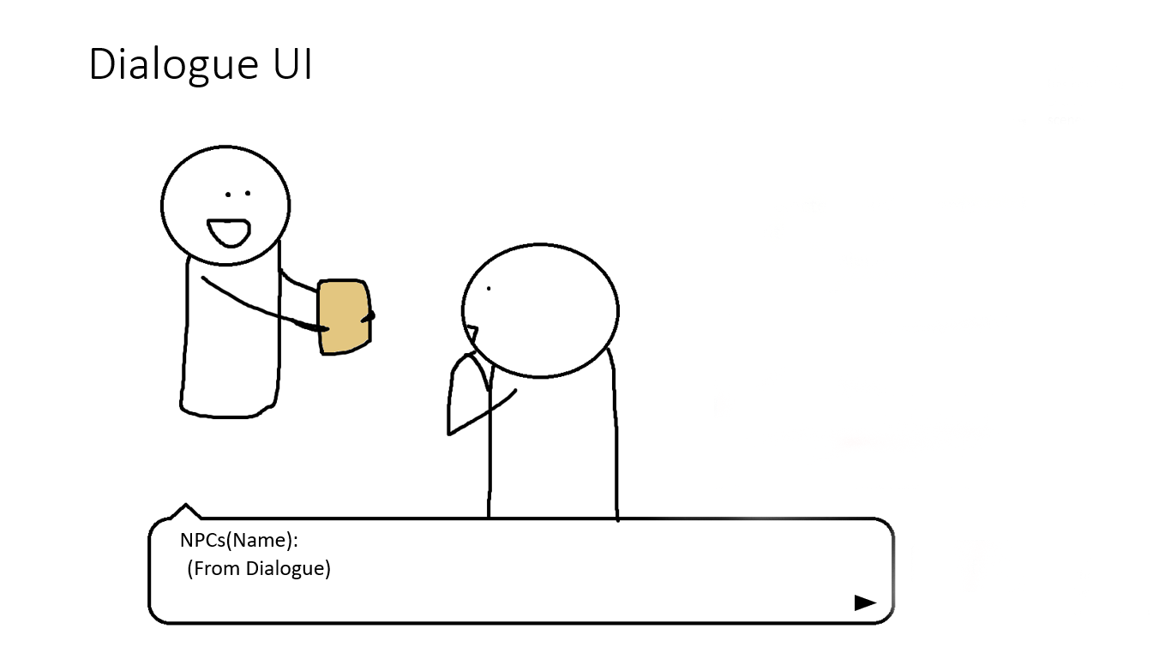

Selected Housing Name
^title will change based on selection
Choose Grants
^same here
Confirm

Slide 9
Dialogue UI
Selected Housing Name
Selected Grant Name
Once the player has confirmed options for both, they can confirm submission to see result
NPCs(Name):
(From Dialogue)
Confirm

Slide 10
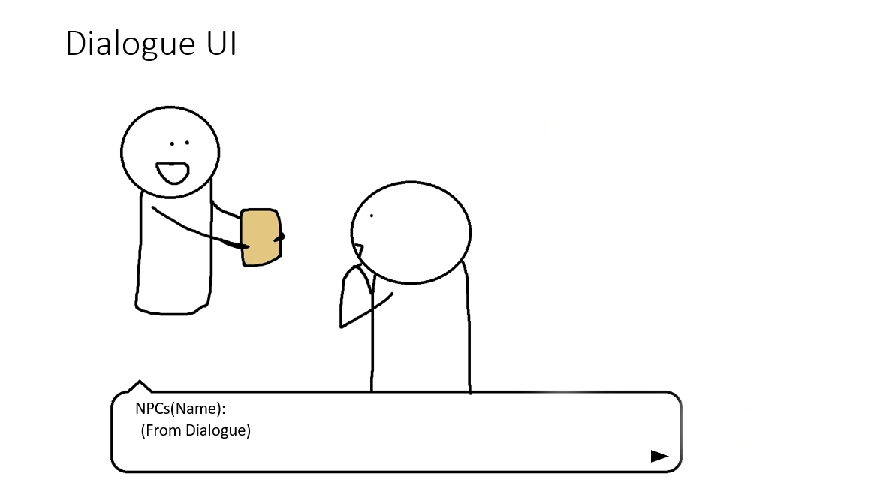
Selected Housing Name
Selected Grant Name
Confirm

Slide 11
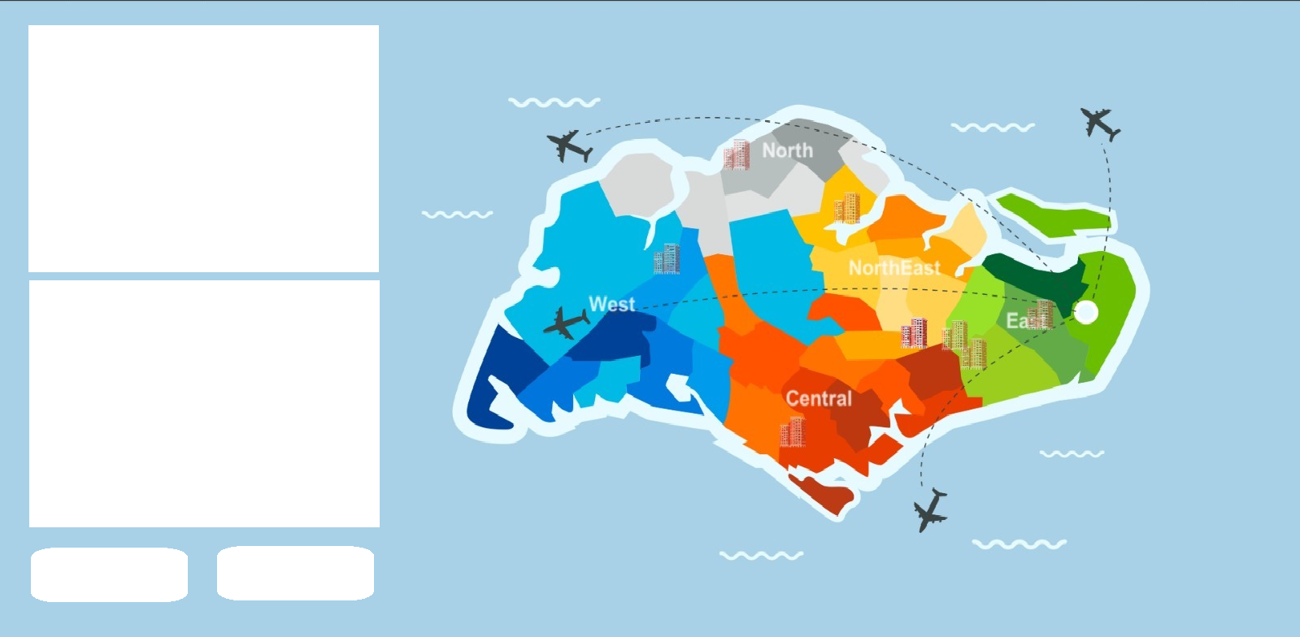
Select House UI
Customer’s needs
The customer’s need is shown here
Information of Selection
Hovering(or maybe just clicking) on specific area(housing or area) will show information
If player is satisfied by their choice, can choose to confirm
Back
Confirm

Slide 12
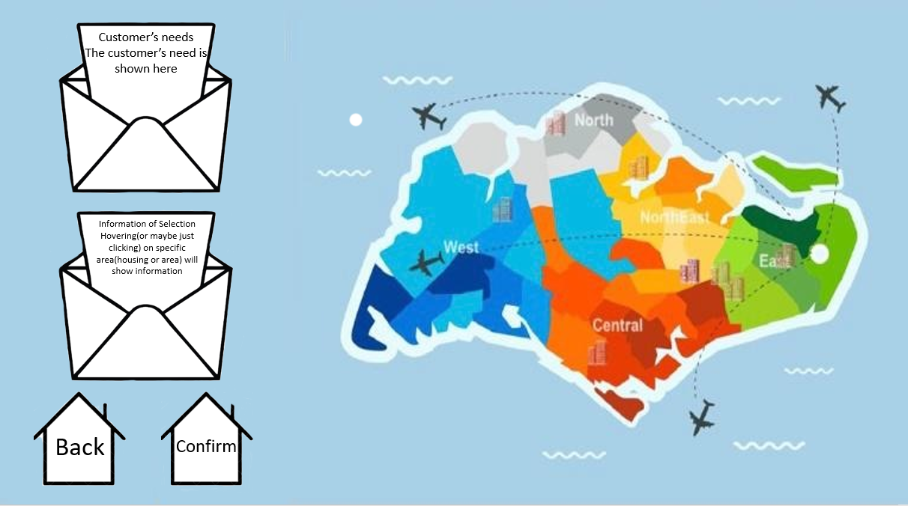

Slide 13
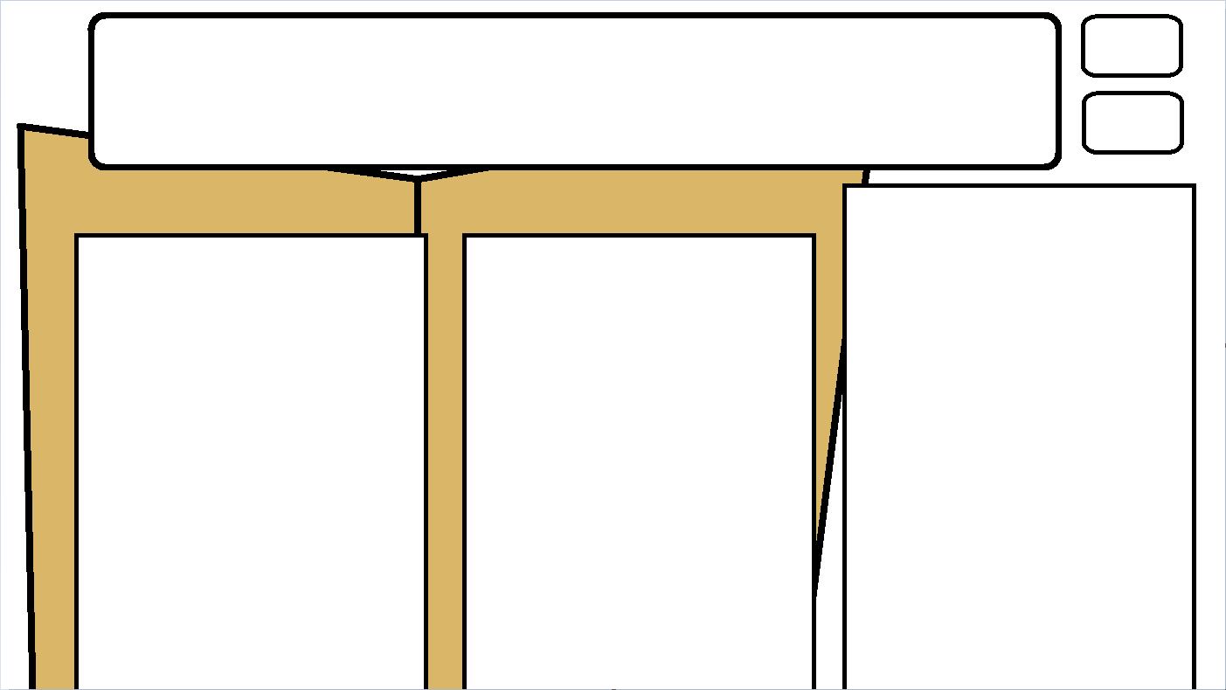
Select Grant UI
The customer’s situation is listed here, which allows players to compare with the information below.
Confirm
Back
Grant Type3 Information
Grant Type1 Information
Grant Type2 Information
Selected option will rise above the rest, and players will click confirm to select choice

